Slide 1
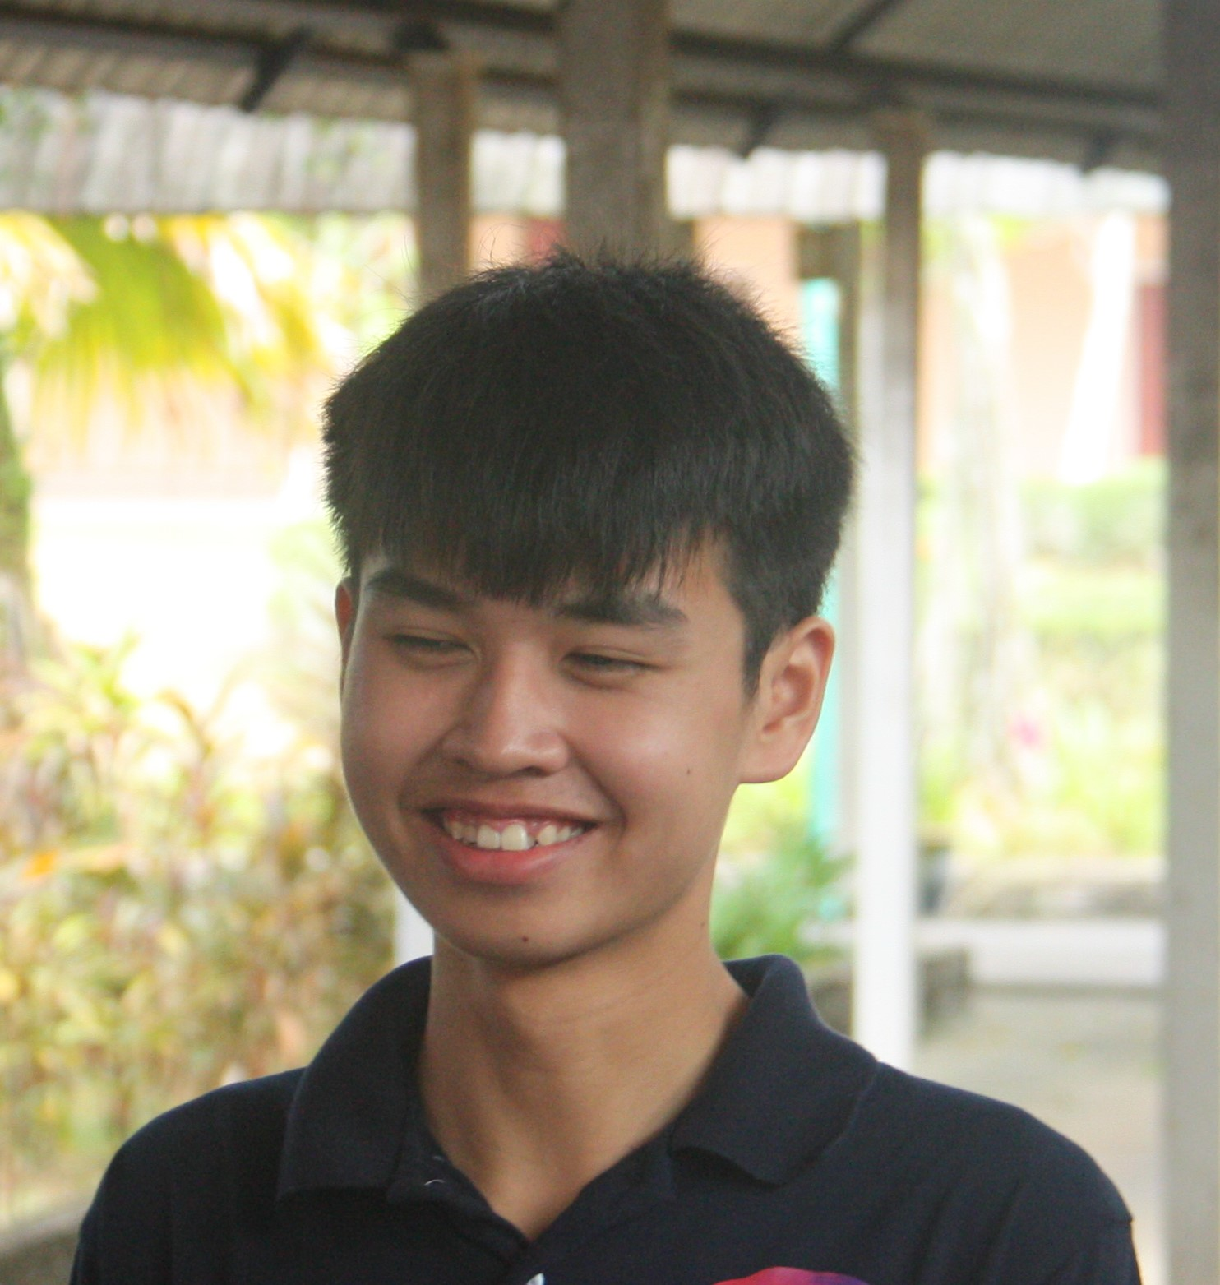
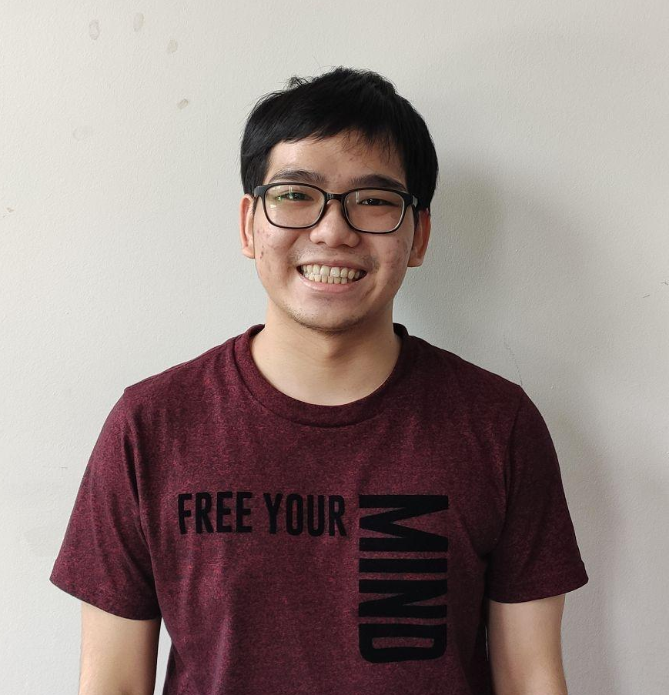
Head Start Machine Learning
Session 2: Python Libraries
Lew Jun Bin
Year 2 CS(SE)
Chin Qi Xiang
Year 2 CS(AI)

Slide 2
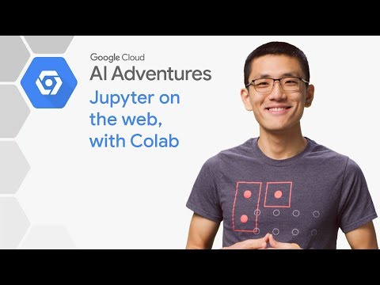
What is Colab?

Slide 3
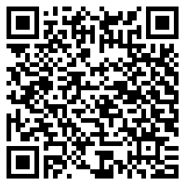
Attendance
What is Colab?
> Select Tab “Head Start Machine Learning”
> Mark your attendance by inserting “1”
> Do it within this 2 hours

Slide 4
What you will learn….
Python Basics
NumPy
Matplotlib
Pandas
Hands-on session
Drop your question in the chat box if you don’t understand anything!

Slide 5
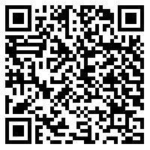
All you need for this workshop...
https://docs.google.com/document/d/1cL0n0XQIHgynrXvqZPQYrfwFN28gJOhWYEqcyve5Rz0/edit?usp=sharing

Slide 6
Q&A

Slide 7
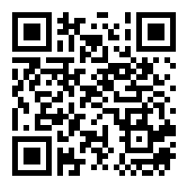
Leave us your feedback
https://forms.gle/Z7TsmUqSYZVDCDGe8

Slide 8
Group photo!

